Slide 1

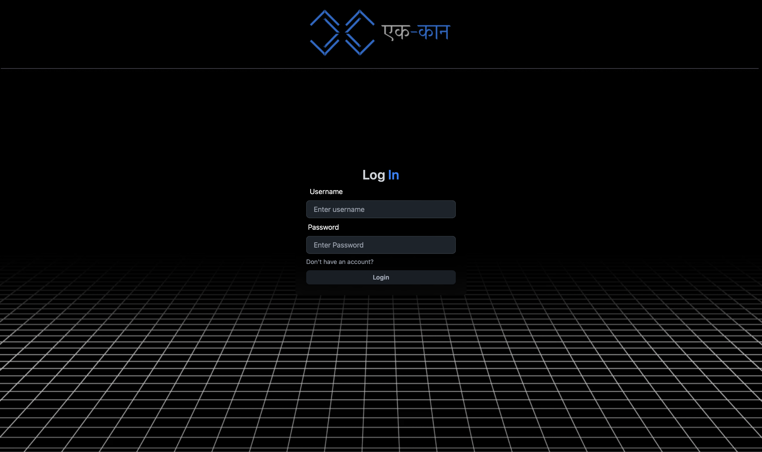
Ek-Kaan
A Chat Web App

Slide 2
Outline
Introduction
Problem Objectives
Literature Review
Diagrams
Methodology

Slide 3
Introduction

Slide 4
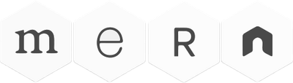
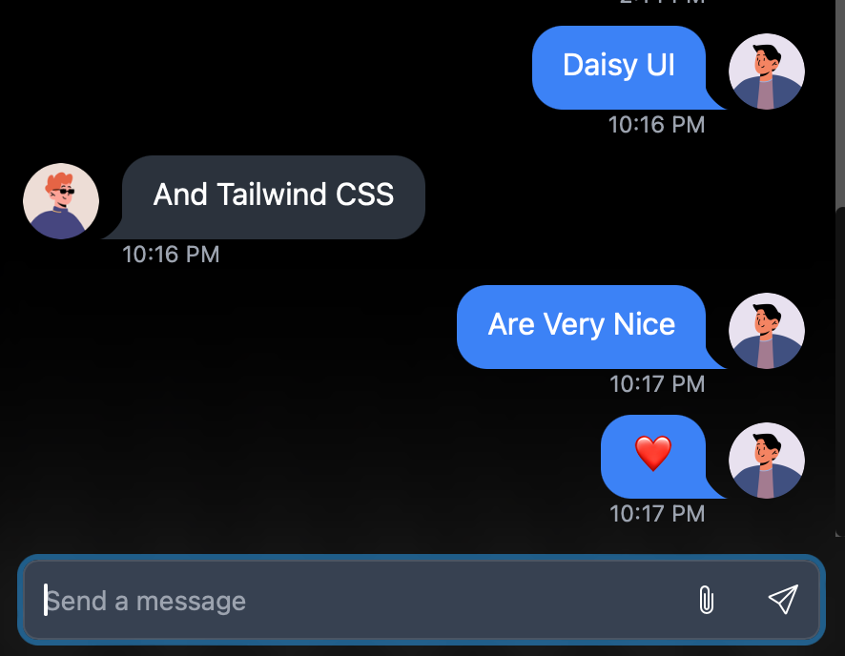
Ek-Kaan is a web chat application built with the MERN stack.
The user interface is designed using Tailwind CSS and DaisyUI
Ek-Kaan facilitates private conversations with a focus on efficiency and security.

Slide 5
Problem Objectives

Slide 6

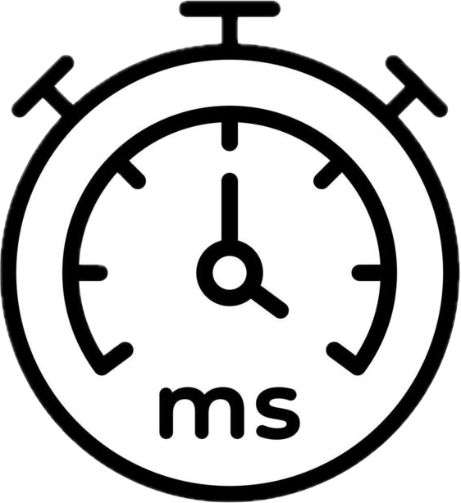

To develop a web application that supports real-time messaging with minimal latency.
Implement robust security features, including secure user authentication.
Ensure data encryption to protect user information and communication.

Slide 7
Literature Review

Slide 8


Available Tools
Matrix Enables decentralized, scalable communication with interoperability between various chat services.
Cons: Complexity in setup and integration may not align with simpler application needs.
Telegram Focuses on fast messaging and large group support with multimedia sharing capabilities.
Cons: Less emphasis on lightweight and real-time communication might not suit simpler use cases.

Slide 9


Available Tools
Chime Integrates voice, video, and chat for comprehensive business communication and collaboration.
Cons: Tightly coupled with Amazon Web Services, which may not fit all deployment environments.
Flock Provides chat, file sharing, task management, and productivity tools to enhance team collaboration..
Cons: Feature-heavy approach may not suit applications seeking a simpler messaging experience

Slide 10
Diagrams

Slide 11
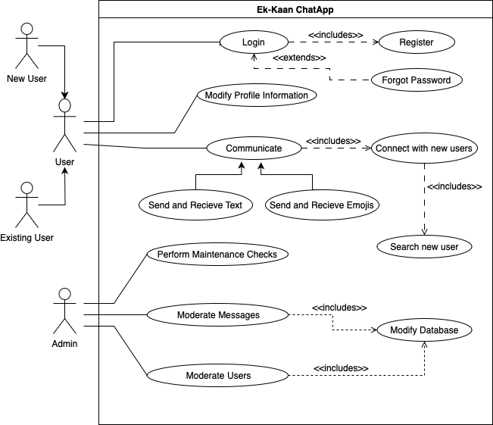
UCD Diagram

Slide 12
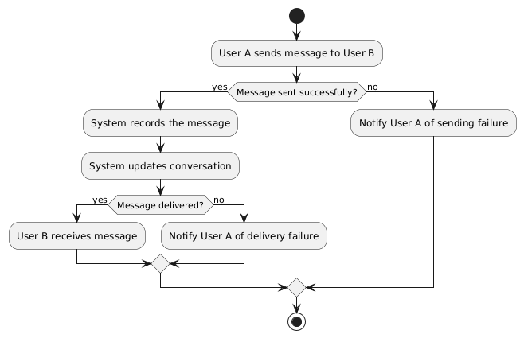
Activity Diagram

Slide 13
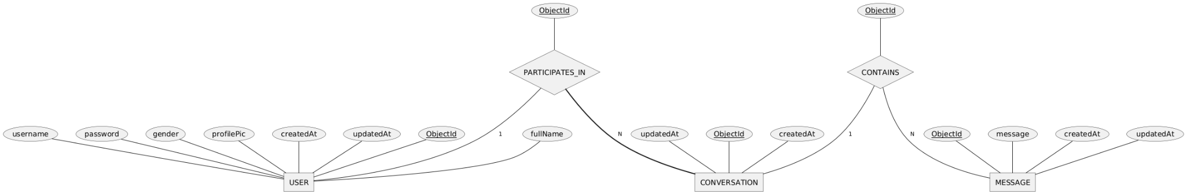
ER Diagram

Slide 14
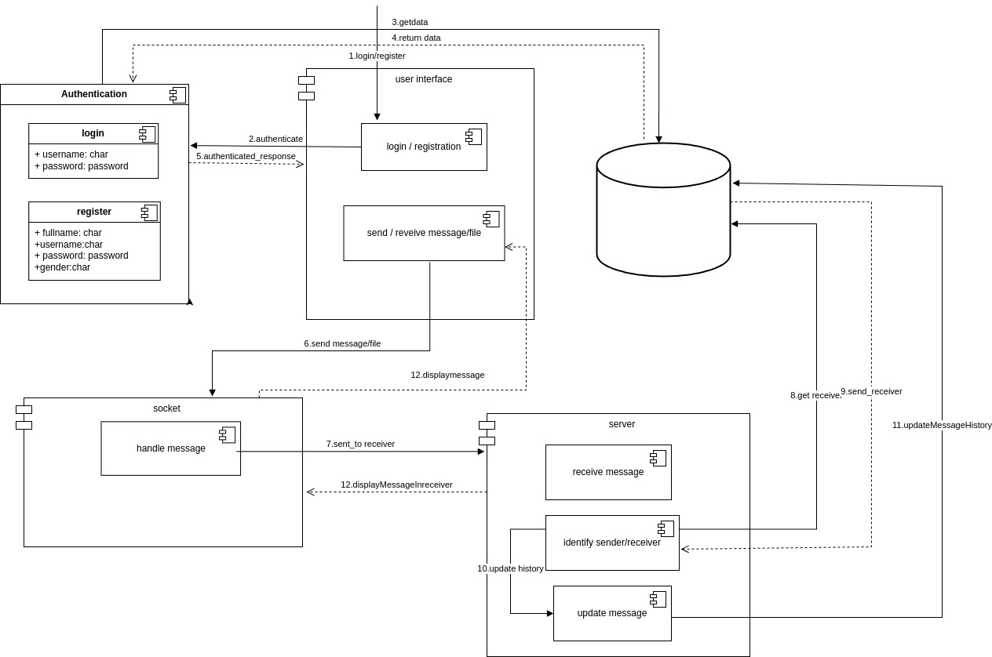
Component Diagram

Slide 15
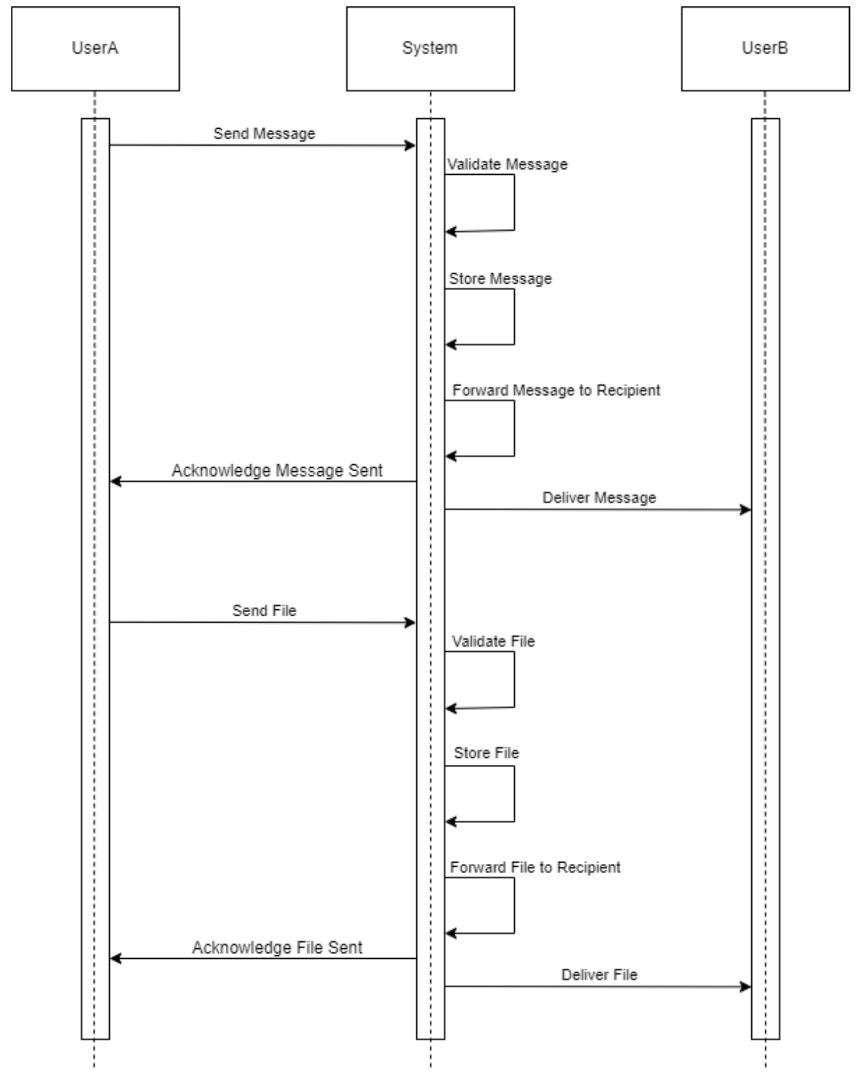
System Sequence Diagram

Slide 16
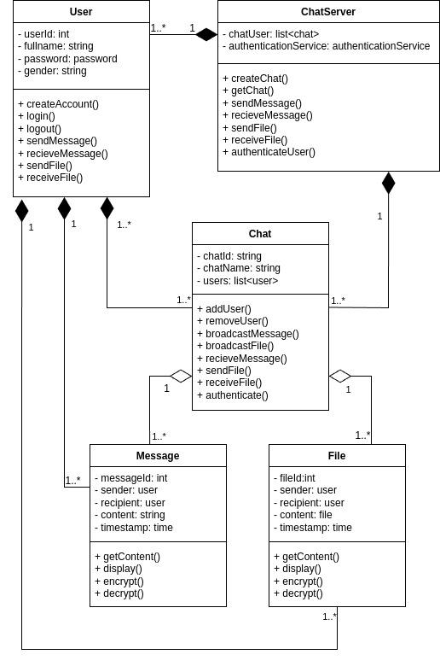
Class Diagram

Slide 17
Methodology

Slide 18
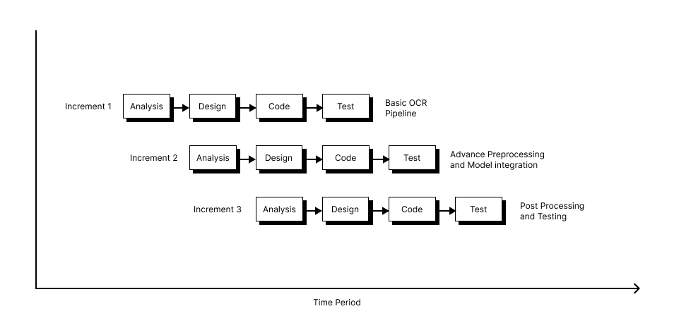
Incremental Model

Slide 19
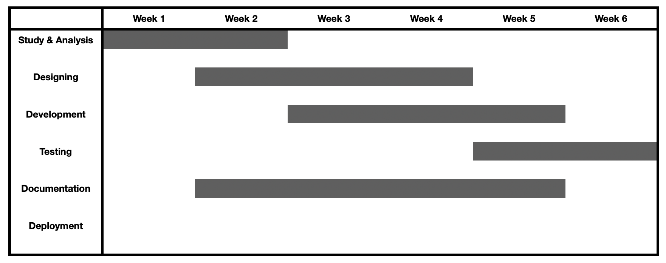
Timeline
Increment 1 - Frontend Development
Design and implement UI components
Integrate core chat features with authentication and routing
Set up real-time messaging UI and connect with backend services

Slide 20
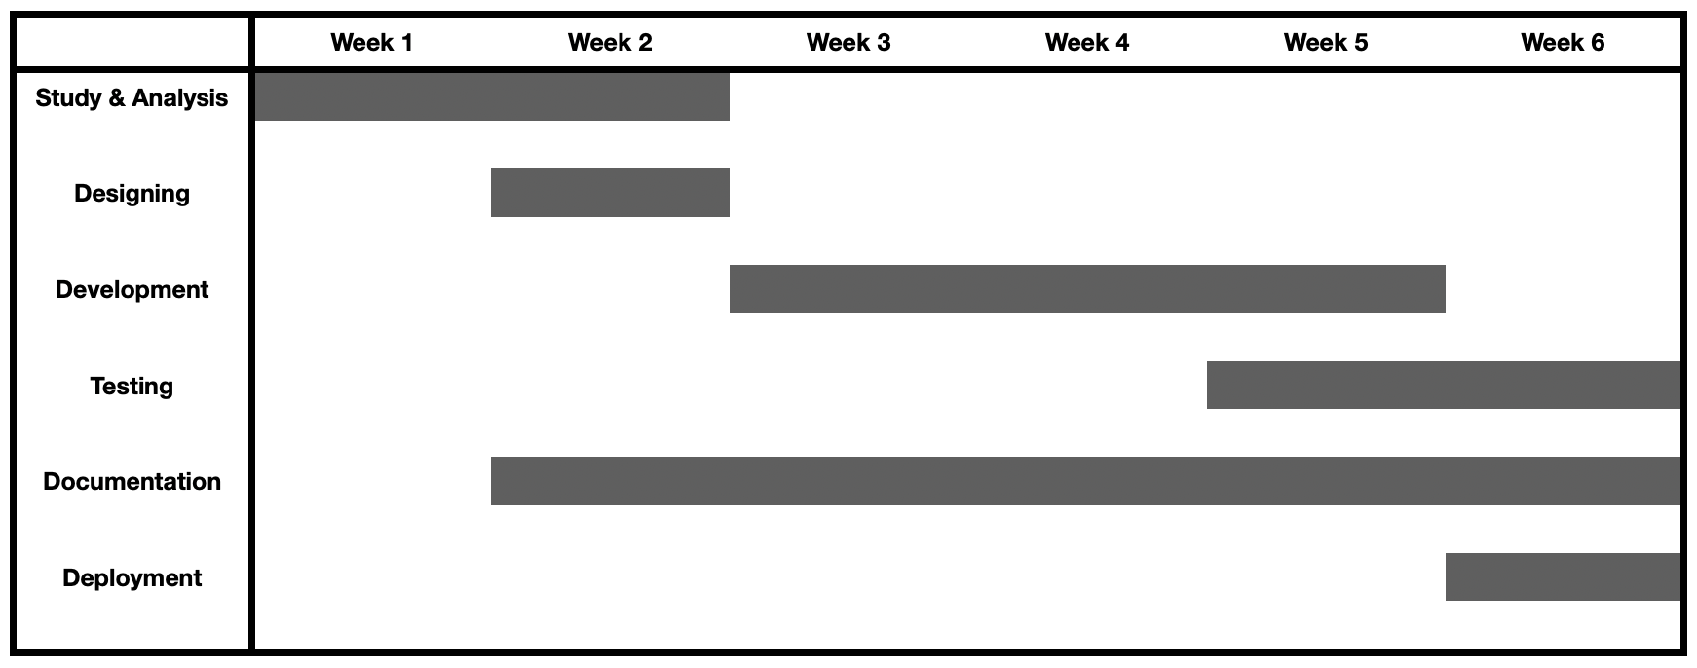
Timeline
Increment 2 - Feature Implementation
Develop and deploy API endpoints for authentication, messaging, and user management
Set up WebSocket server for real-time communication
Implement file handling, storage, and database integration

Slide 21
Timeline
Increment 3 - Deployment and Integration
Perform unit and integration testing of frontend and backend
Conduct end-to-end testing for complete user flows
Optimize performance, security, and finalize deployment configurations

Slide 22
Appendix

Slide 23
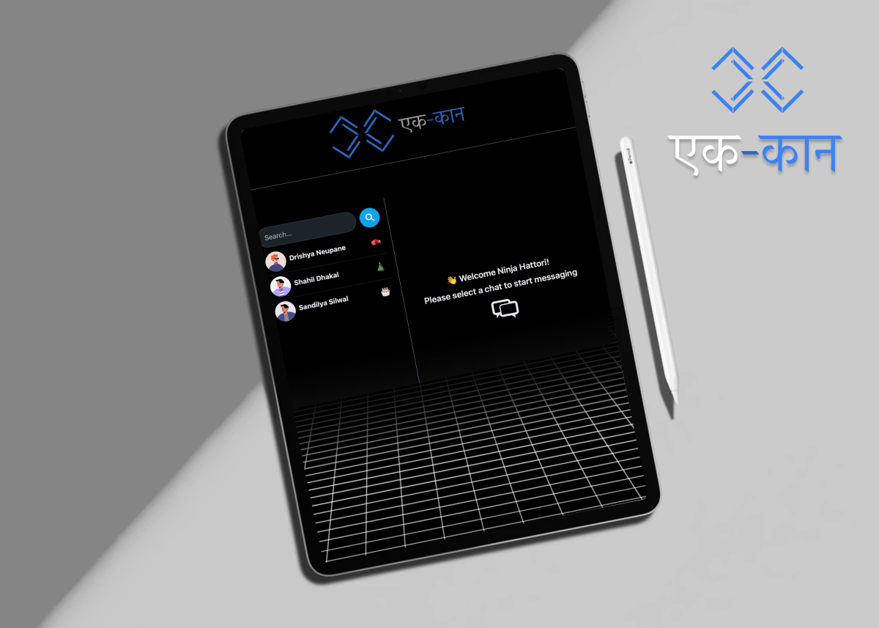
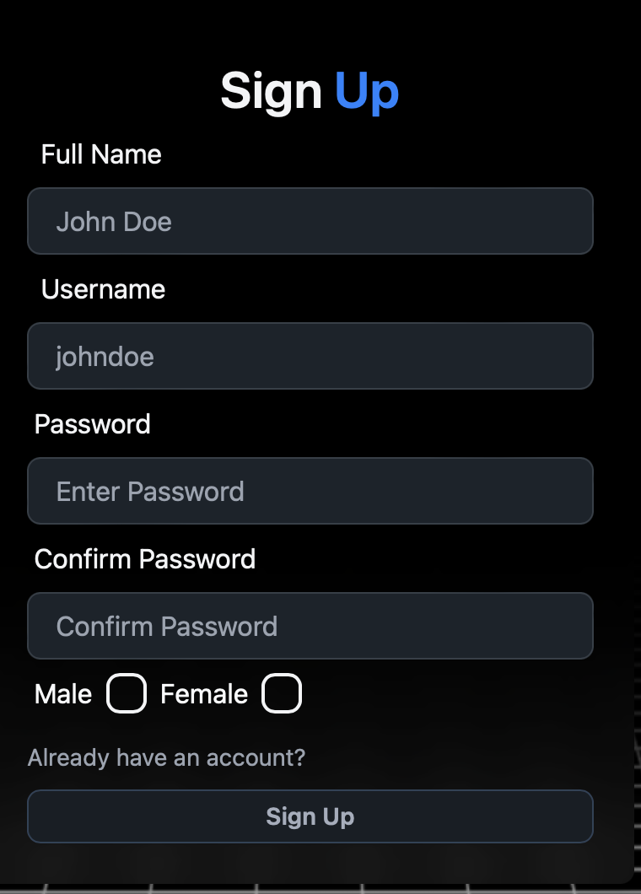
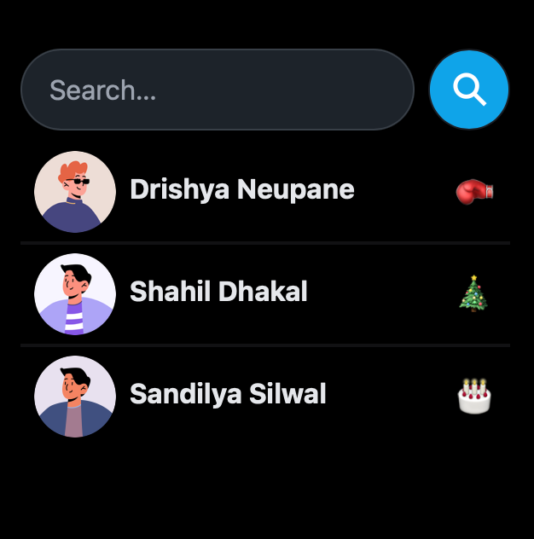
‹#›

Slide 24
Thank you for your time :)

